Slide 1
Traffic Management
Phase-2:Innovation
Submitted by
E.Naveenraj
S.Sakthivel
M.Manimaaran
M.sachin
P.Sanmugam

Slide 2
ABSTRACT
Traffic congestion is a major problem in many cities of India along with other countries. Failure of signals, poor law enforcement and bad traffic management has lead to traffic congestion. One of the major problems with Indian cities is that the existinginfrastructure cannot be expanded more, and thus the only option available is better management of the traffic. Traffic congestion has a negative impact on economy, the environment and the overall quality of life. Hence it is high time to effectively manage the traffic congestion problem. There are various methods available for traffic management such as video data analysis, infrared sensors, inductive loop detection, wireless sensor network, etc. All these methods are effective methods of smart traffic management. But the problem with these systems is that the installation time, the cost incurred for the installation and maintenance of the system is very high. Hence a new technology called Radio Frequency Identification (RFID) is introduced which can be coupled with the existing signaling system that can act as a key to smart traffic management in real time. This new technology which will require less time for installation with lesser costs as compared to other methods of traffic congestion management. Use of this new technology will lead to reduced traffic congestion. Bottlenecks will be detected early and hence early preventive measures can be taken thus saving time and money of the driver.

Slide 3
Keywords RFID, GSM, Traffic congestion
INTRODUCTION
Traffic congestion on road networks is nothing but slower speeds, increased trip time and increased queuing of the vehicles. When the number of vehicles exceeds the capacity of the road, traffic congestion occurs. In the metropolitan cities of India traffic congestion is a major problem. Traffic congestion is caused when the demand exceeds the available road capacity. This is known as saturation [1] . Individual incidents such as accidents or sudden braking of a car in a smooth flow of heavy traffic have rippling effects and cause traffic jams [2] . There are even severe security problems in traffic system due to anti social elements which also leads to stagnation of traffic at one place. In country like India, there is an annual loss of Rs 60,000 crores due to congestion (including fuel wastage). Congestion in India has also led to slow speeds of freight vehicles, and increased waiting time at checkpoints and toll plazas [3] . The average speed of vehicles on key corridors like Mumbai-Chennai, Delhi-Chennai is less than 20kmph, while it is mere 21.35kmph on Delhi-Mumbai stretch. As per the transport corporation of India and IIM, India’s freight volume is increasing annually at a rate of 9.08% and that of vehicles at 10.76%, but that of road is only by 4.01%.

Slide 4
2. EXISTING METHODOLOGY
2.1 Inductive Loop Detection
Inductive loop detection works on the principle that one or more turns of insulated wire are placed in a shallow cutout in the roadway, a lead in wire runs from roadside pull box to the controller and to the electronic unit located in the controller cabinet. When a vehicle passes over the loop or stops, the induction of the wire is changed. Due to change in induction, there is change in the frequency. This change in the frequency causes the electronic unit to send a signal to the controller; indicating presence of the vehicle [6] .Inductive loop detection is useful in knowing the vehicle presence, passage, occupancy and even the number of vehicles passing through a particular area [6,7] . But there are few problems with this system. These include poor reliability due to improper connections made in the pull boxes and due to application of sealant over the cutout of the road. If this system is implemented in poor pavement or where digging of the roads is frequent then the problem of reliability is aggravated

Slide 5
2.2 Video Analysis
Video analysis consists of a smart camera placed which consists of sensors, a processing unit and a communication unit [9] . The traffic is continuously monitored using a smart camera. The video captured is then compressed so as to reduce the transmission bandwidth. The video analysis abstracts scene description from the raw video data. This description is then used to compute traffic statistics. This statistic includes frequency of the vehicles, average speed of the vehicles as well as the lane occupancy [9,10] .The problems associated with video analysis are – (a) the overall cost of the system is quite high (b) the system gets affected in case of heavy fog or rains (c) night time surveillance requires proper street lighting

Slide 6
2.3 Infrared Sensors
Infrared sensors are used to detect energy emitted from vehicles, road surfaces and other objects. The energy captured by these infrared sensors is focused onto an infrared sensitive material using an optical system which then converts the energy into the electric signals. These signals are mounted overhead to view the traffic. Infrared sensors are used for signal control, detection of pedestrians in crosswalks and transmission of traffic information.
The basic disadvantages of infrared sensors are that the operation of the system may be affected due to fog; also installation and maintenance of the system is tedious

Slide 7
3. SMART TRAFFIC MANAGEMENT SYSTEM
1) RFID Controller:
The RFID controller consists of RFID interrogator. This interrogator is used for the communication with the RFID tag. The RFID controller then gets the signals/data received by the interrogator. Messaging interference is used to send commands and data messages from the controller components. Controller core is present inside the RFID controller. The controller core listens to the interrogators and depending upon the configuration; the controller core can perform read/write operations upon the RFID tag or can do both listening and performing operations [5] .The RFID controller can have serial interface through which external GSM/GPRS devices can be interfaced with it to make a dual radio device

Slide 8
2) RFID Tag:
RFID tags are wireless devices which make use of radio frequency electromagnetic fields to transfer data, which is used for identifying and tracking of the objects. RFID tags are of two types: Active and Passive [12] . Active RFID has a battery installed, which the passive RFID doesn’t have. Passive RFID has to depend on external source for working. Tags information can be stored in a non-volatile memory. Tag consists of a Radio Frequency transmitter and receiver. Each tag can be assigned a unique serial number

Slide 9
System Overview
Each vehicle can be installed with a RFID tag. This RFID tag would store all the information regarding the vehicle such as the vehicle number, etc. RFID tags can be used in identifying each vehicle uniquely and also help the driver to receive some traffic messages. The existing signaling system can be coupled with the RFID controller. As described in figure 1, each signal can have the information regarding every vehicle that passes by it. Thus when a vehicle passes by a signal, the signal can automatically keep the count of the vehicles passing by it, and help in detection of traffic congestion. Each signal should be stored with a threshold value for which it should be red and green. Now depending upon the frequency of the vehicles passing by the signal per second, the timer can be dynamically controlled. Each controller of the signal should be stored with a value of minimum frequency of the vehicles passing by the signal. As soon as this minimum frequency is reached, the controller should send a command to the signal to turn red. Thus the signal is controlled dynamically. For example, suppose for a signal, maximum time for which a signal can be red is set to be 30 seconds and maximum time for which the signal can be green is set as 20 seconds. The controller is stored with the value of minimum frequency of vehicles passing by it per second as 5. Now suppose the signal turns green, the timer starts with a maximum value of 20. Initially the frequency of the vehicles passing the signal per second is 10, after 10 seconds this frequency reduces to 5, and then automatically the RFID controller sends a command to the signal to turn red. Thus the signal turns red and its adjacent signal in that junction turns green. This process continues in a cycle. Thus dynamic controlling of the signal helps in reducing the wastage of time. This also helps in avoiding traffic congestion as priority is given to a high vehicular traffic road. This system helps in detection of traffic congestion. If the frequency of the vehicles passing the signal per second remains higher than the value.

Slide 10
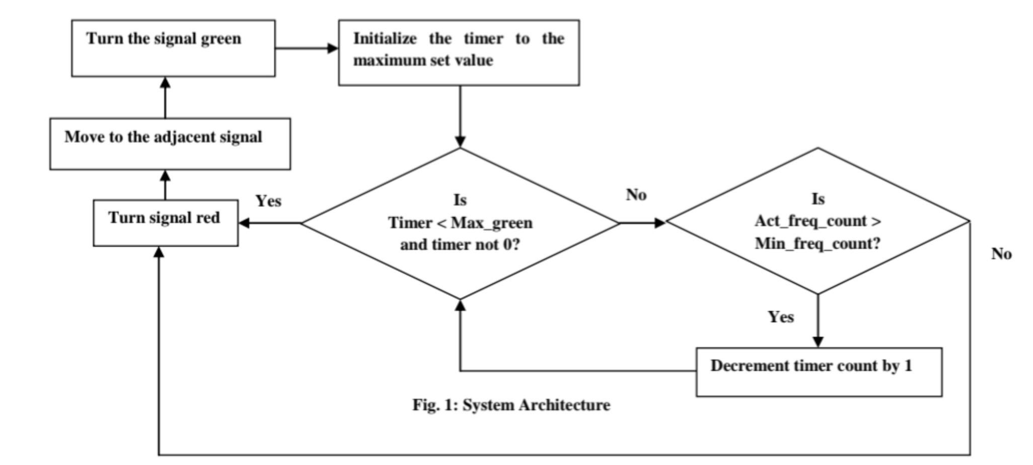
the maximum value of the timer is reached, then the congestion has occurred at that point. Once the congestion has been detected, the RFID controller can send a message to its preceding signal’s controller notifying it to temporarily stop traffic along that stretch. After receiving the message from its successor signal the RFID controller will put ON the red signal for that stretch towards that congested crossing point for a predefined time period. When the congestion is released at the crossing, the respective signal’s controller will send another message to its earlier controller indicating to resume the traffic flow again in that direction. Accepting this message the controller of the preceding signal put the red light OFF and green signal ON and restart the signal cycle as before

Slide 11
4. APPLICATIONS
4.1 Detection and Management of traffic Congestion
In addition to the earlier method of traffic congestion detection, one more methodata calculated by the Controller of the signals. The main aim is to implement a system d can be used. A server can be maintained which can receive certain crucial that would trace the travel time of individual cars as they pass the roadside controllers and compute.
An average trip time using a rule-based system to decide whether the area is congested or uncongested. If congestion is sensed then system would control traffic signals / generate automatic re-routing messages to selected approaching vehicles.

Slide 12
4.2 Automatic Billing of Core Area / Toll Charges
Automatic toll collection and automatic ―core area charge‖ collections are also done using the same framework. Controller unit will be placed at toll-booth and along the motor able roads around the core area which will detect each individual vehicle uniquely within its zone by capturing their device ids and will keep records of the time during which the vehicle was seen by those Controllers within its reading zone. This information will be sent to a main server. Accordingly the main server will calculate the charges and raise bills against the vehicle ids

Slide 13
5. CONCLUSION AND FUTURE WORK
The proposed work focuses on Smart Traffic management System using RFID which will eliminate the drawbacks of the existing system such as high implementation cost, dependency on the environmental conditions, etc. The proposed system aims at effective management of traffic congestion. It is also cost effective than the existing system.

